Slide 1


Mobile Learning Application Development
Presented By:
Rakib Hossen
Assistant Professor
Dept. of Cyber Security Engineering (CySE), UFTB

Slide 2
Form Validation in Flutter

Slide 3
Form Validation in Flutter
Form Validation is an important part
application, there are many ways to
of every application. In the flutter
validate form such as using a
TextEditingController. But handling text controller for every Input can be messy
in big applications. Hence, Form provides us a convenient way to validate user Inputs.

Slide 4

Form Validation in Flutter
In form, the input is validated in your submit function(the function which is called once the user has entered every detail, But the condition is applied in each TextFormField itself with a widget name validator as shown in the below given example.
The Validator widget takes a function with a parameter that contains the value of the single input and then it checks the condition which is given in the validator function. The key is used in this because there can be many inputs so to connect the widget tree with elementary tree key of type FormState is used.

Slide 5
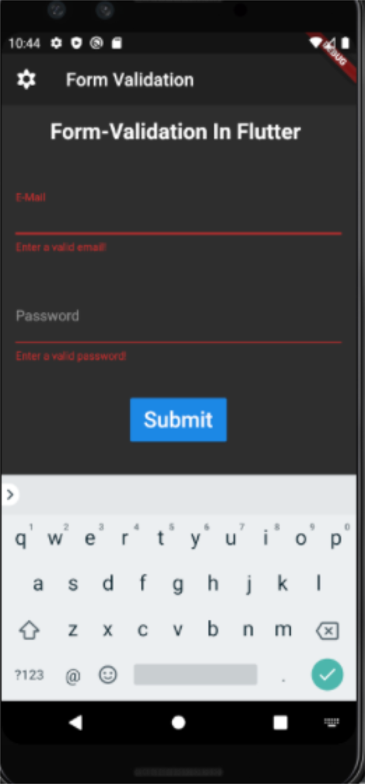
Form Validation in Flutter

Slide 6
Customizing Fonts in Flutter

Slide 7
Customizing Fonts in Flutter
In Flutter, everything is a widget. So, “Text” is a widget too. The text widget has
its own properties like font style, font size, font-weight, etc. The Flutter team has set a few default properties before making things easier for the user to create apps. So, customizing text is all about editing these properties as we want, to get the desired output.

Slide 8
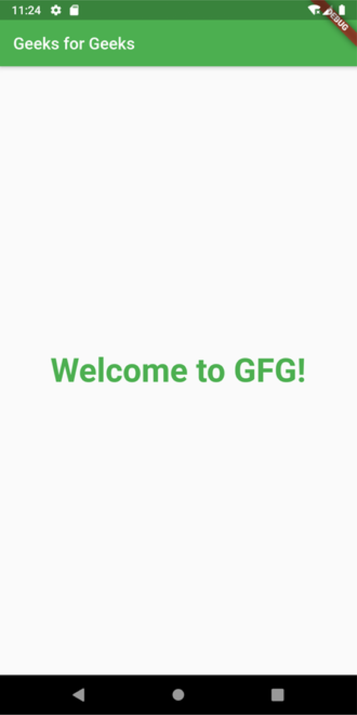
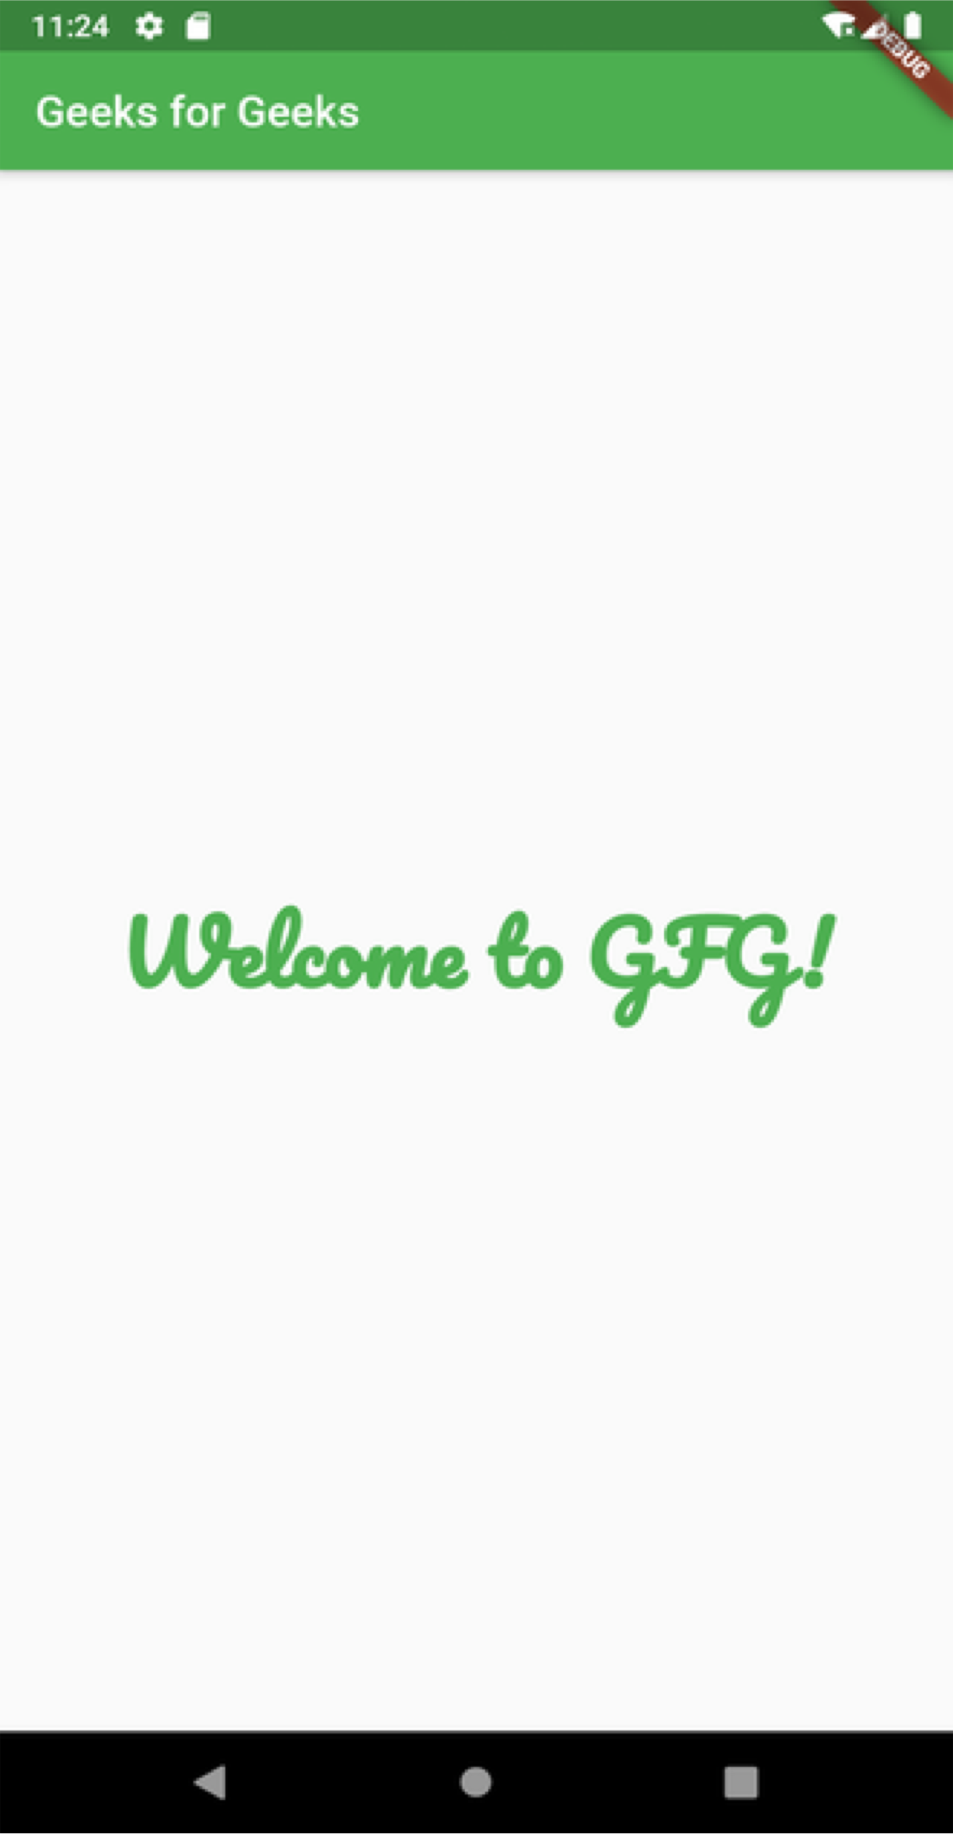
Customizing Fonts in Flutter

Slide 9
Custom Fonts in Flutter
Download Font File: A Font file has all the required details regarding a font family, so once imported the font style can be used throughout the app. Google Fonts website has a wide variety of font families that can be downloaded and used in an app. The steps for downloading the file are as follows:
Step 1: Open Google Fonts and search for a font family in the search bar (here “Pacifico”).
Step 2: Select the “Pacifico” font file.
Step 3: To download, click the “Download Family” button.

Slide 10
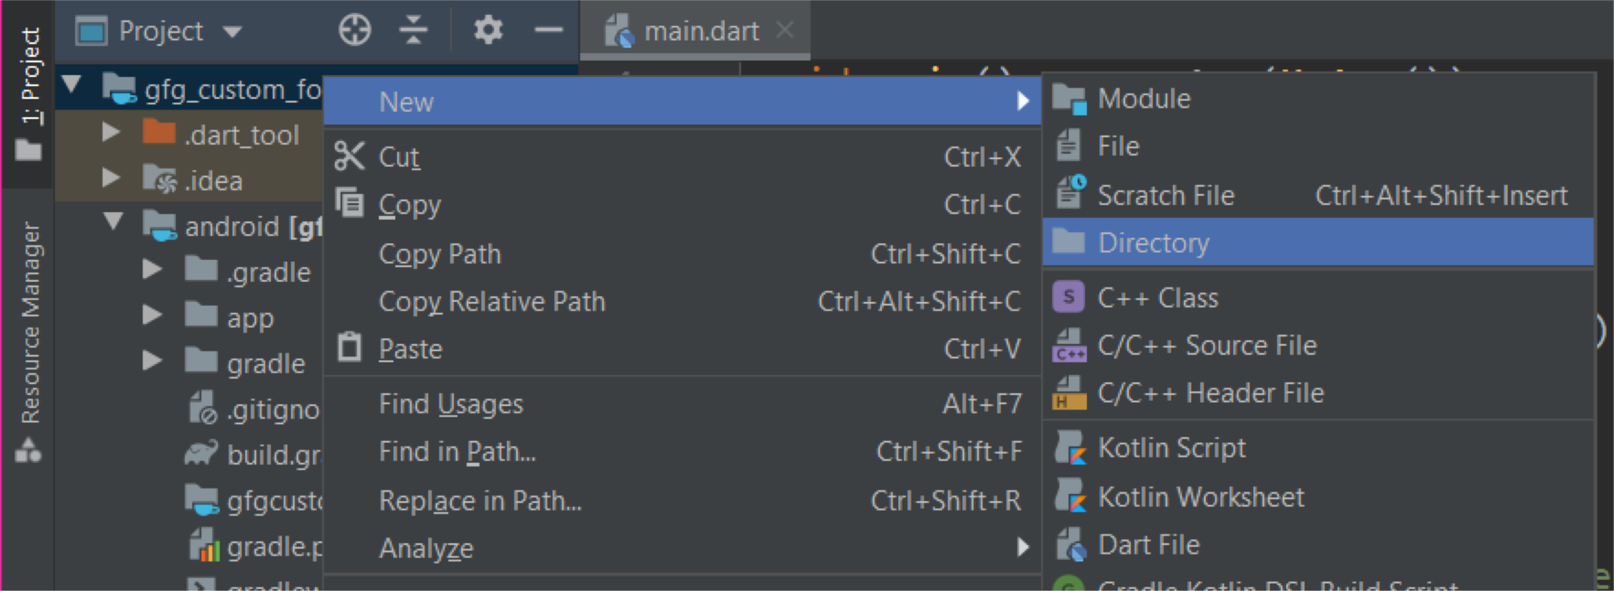
Add a font to your project
To use the downloaded font family, we need to import the font file into the root of the Flutter app. The steps for importing the font file in Android Studio are as follows:
Step 1: Click the “Project” button in the top left corner of Android Studio.
Step 2: Right-click on the project name, here “project_name” and select New + Directory.
Step 3: Name the directory as “fonts“.
Step 4: Open file manager and go to downloads. Extract and open the “Pacifico” zip file.
Step 5: Move the “Pacifico Regular” file into this directory. After moving, the font directory contains a file named “Pacifico-Regular.ttf”.

Slide 11
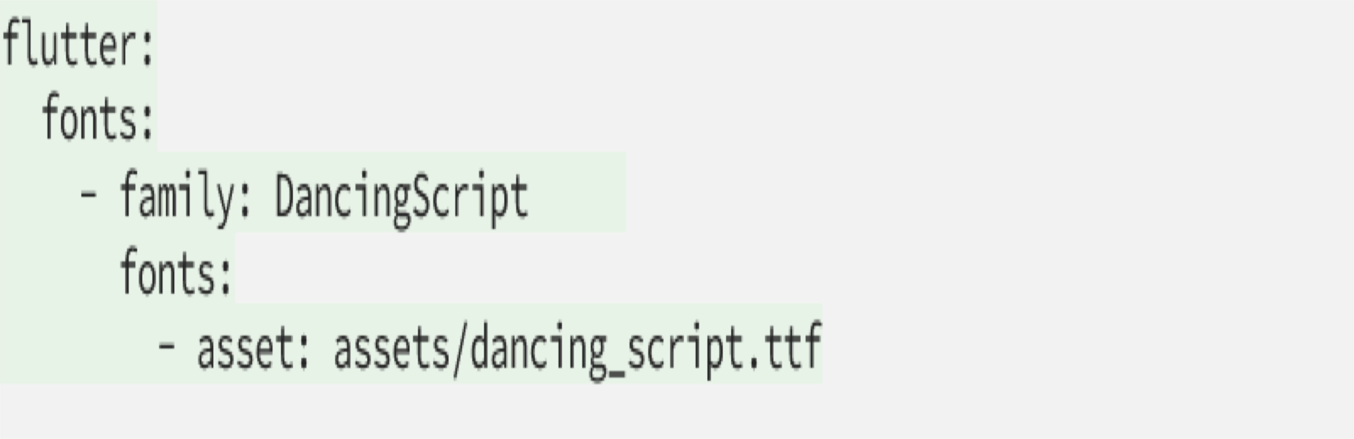
Register the font
Open your pubspec.yaml file.
Add the fonts info under the flutter section. Indentation is mandatory.

Slide 12
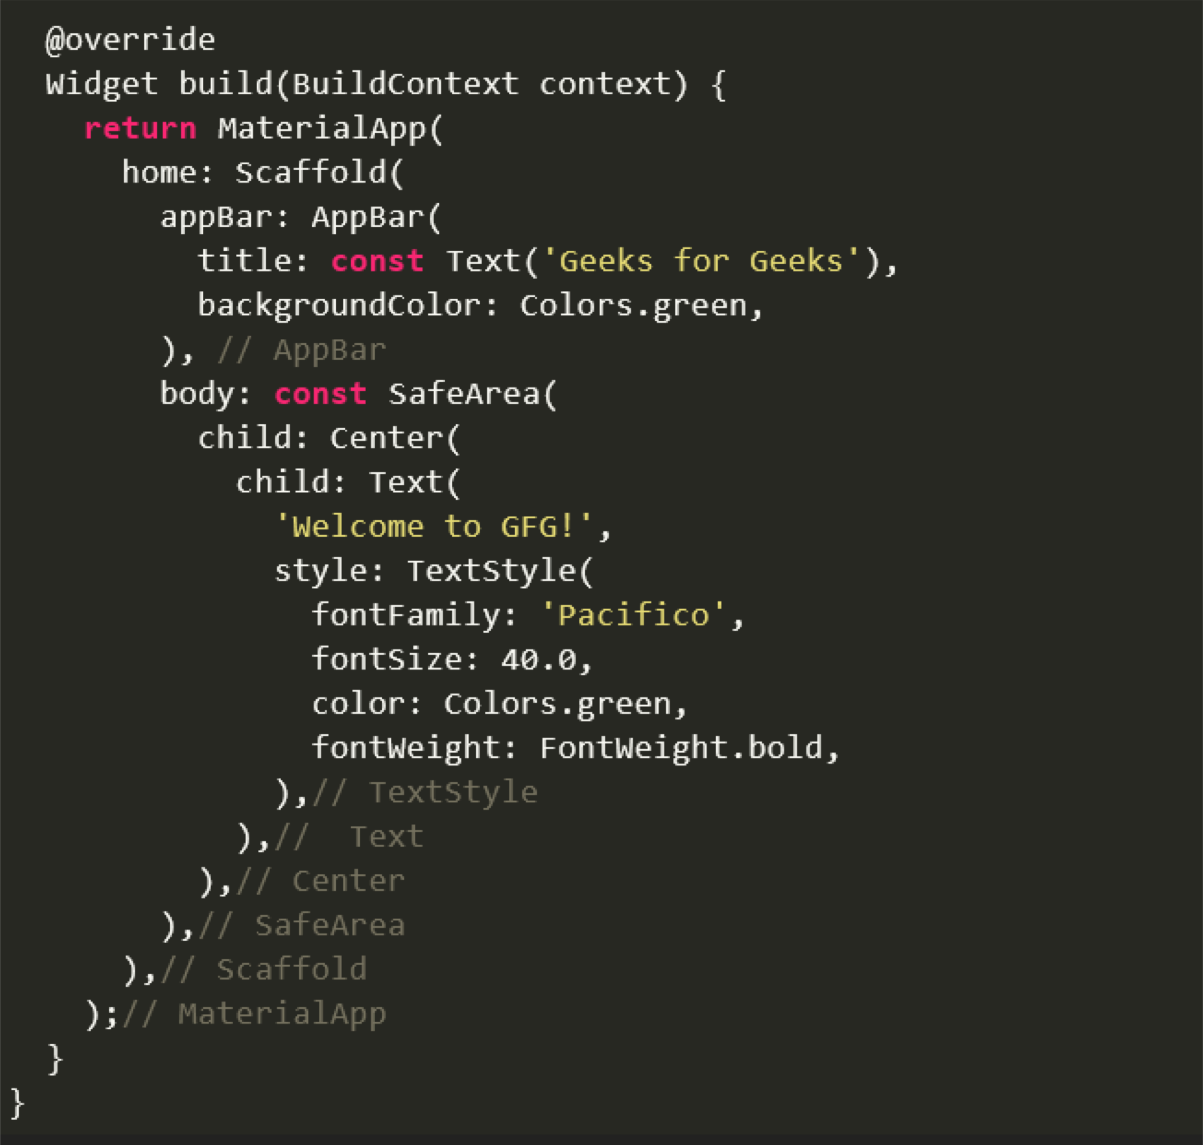
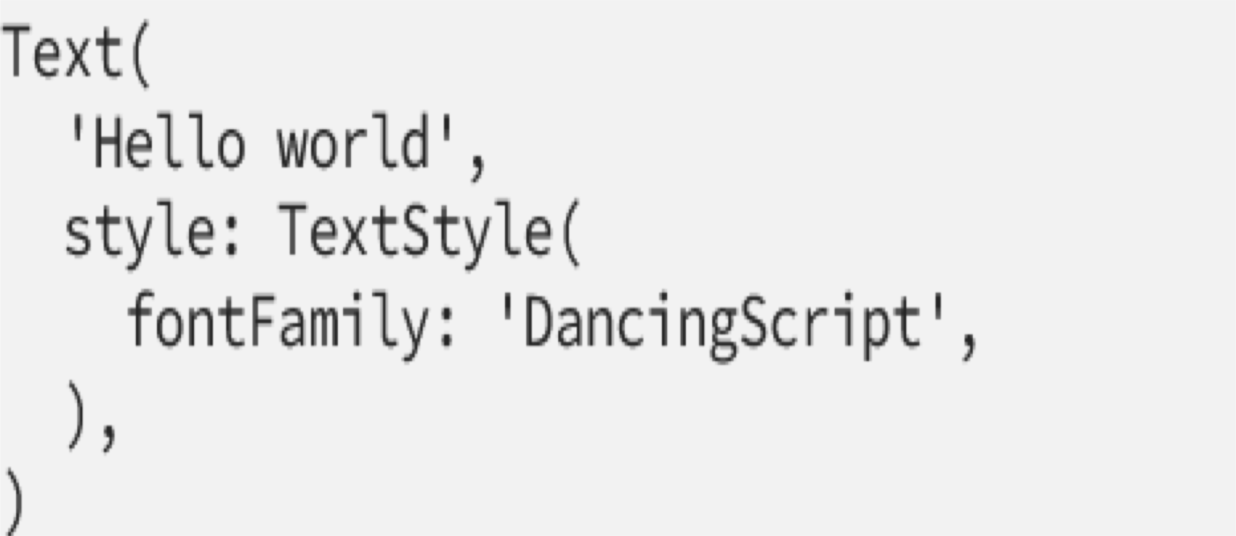
Use the font in your theme or widget
Now you can use your font by setting the fontFamily attribute in the TextStyle widget to whatever you called it in pubspec.yaml.

Slide 13
Flutter – Skeleton Text

Slide 14
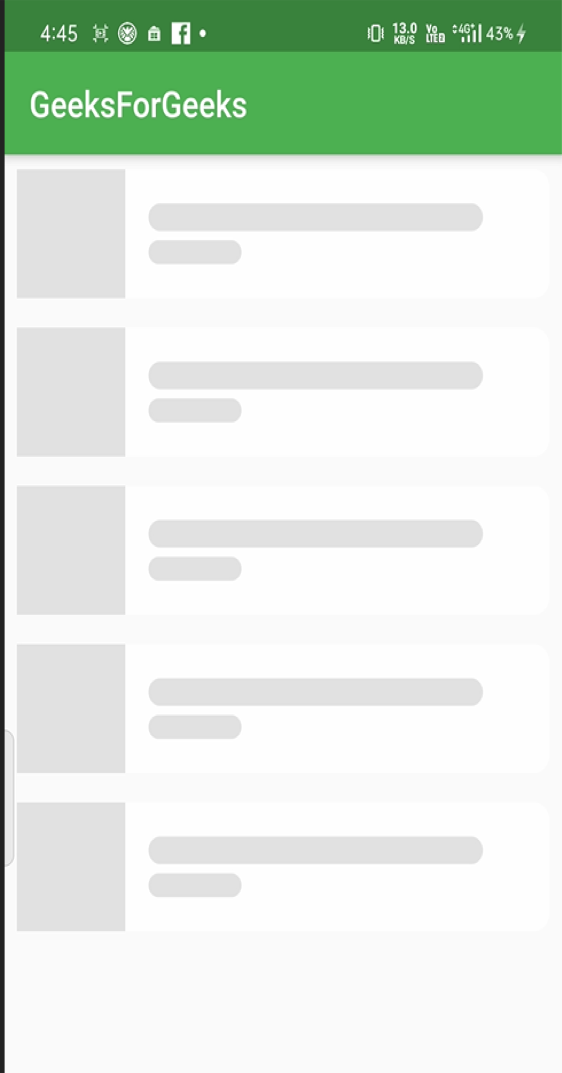
Flutter – Skeleton Text
In Flutter, the skeleton_text library is used to easily
implement skeleton text loading animation. Its main application in a flutter app is to assure its users that the servers are working but running slow, but the content will eventually load. It also enhances the UI if the user connection is slow too.

Slide 15
Flutter – Skeleton Text
Process of adding Skeleton Text
Add the skeleton_text dependency to the pubspec.yaml file
Import the dependency to the main.dart file
Build a simple app structure to implement the dependency
Call the SkeletoAnimation method in the body of the app

Slide 16
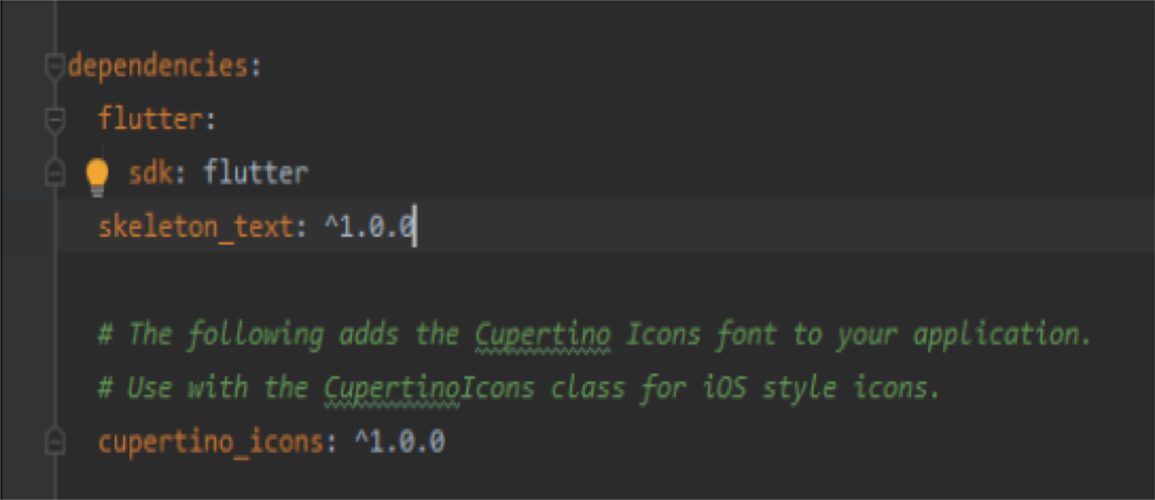
Adding dependency

Slide 17
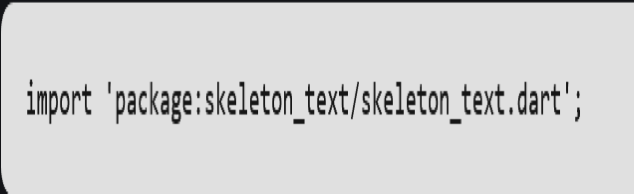
Importing the Dependency

Slide 18
Flutter Gestures

Slide 19
Flutter Gestures
Gestures are an interesting feature in Flutter that allows us to interact with the mobile app (or any touch-based device). Generally, gestures define any physical action or movement of a user in the intention of specific control of the mobile device. Some of the examples of gestures are:
When the mobile screen is locked, you slide your finger across the screen to unlock it.
Tapping a button on your mobile screen, and
Tapping and holding an app icon on a touch-based device to drag it across screens

Slide 20
Flutter Gestures
We use all these gestures in everyday life to interact with your phone or touch- based device. Flutter divides the gesture system into two different layers, which are given below:
Pointers
Gestures

Slide 21
Pointers
Pointers are the first layer that represents the raw data about user interaction. It has events, which describe the location and movement of pointers such as touches, mice, and style across the screens. Flutter does not provide any mechanism to cancel or stop the pointer-events from being dispatched further. Flutter provides a Listener widget to listen to the pointer-events directly from the widgets layer. The pointer-events are categories into mainly four types:
PointerDownEvents
PointerMoveEvents
PointerUpEvents
PointerCancelEvents

Slide 22
Pointers
PointerDownEvents: It allows the pointer to contact the screen at a particular location.
PointerMoveEvents: It allows the pointer to move from one location to another location on the screen.
PointerUpEvents: It allows the pointer to stop contacting the screen.
PointerCancelEvents: This event is sent when the pointer interaction is canceled.

Slide 23
Gestures
It is the second layer that represents semantic actions such as tap, drag, and scale, which are recognized from multiple individual pointer events. It is also able to dispatch multiple events corresponding to gesture lifecycle like drag start, drag update, and drag end. Some of the popularly used gesture are listed below:
Tap
Double Tap
Drag
Long Press
Pan
Pinch

Slide 24
Gestures
Tap: It means touching the surface of the screen from the fingertip for a short time and then releasing them. This gesture contains the following events:
onTapDown
onTapUp
onTap
onTapCancel

Slide 25
Gestures
Tap: It means touching the surface of the screen from the fingertip for a short time and then releasing them. This gesture contains the following events:
onTapDown
onTapUp
onTap
onTapCancel
Double Tap: It is similar to a Tap gesture, but you need to tapping twice in a short time. This gesture contains the following events:
onDoubleTap

Slide 26
Gestures
Drag: It allows us to touch the surface of the screen with a fingertip and move it from one location to another location and then releasing them. Flutter categories the drag into two types:
1. Horizontal Drag: This gesture allows the pointer to move in a horizontal direction. It contains the following events:
onHorizontalDragStart
onHorizontalDragUpdate
onHorizontalDragEnd
2. Vertical Drag: This gesture allows the pointer to move in a vertical direction. It contains the following events:
onVerticalDragStart
onVerticalDragUpdate
onVerticalDragEnd

Slide 27
Gestures
Long Press: It means touching the surface of the screen at a particular location for a long time. This gesture contains the following events:
onLongPress
Pan: It means touching the surface of the screen with a fingertip, which can move in any direction without releasing the fingertip. This gesture contains the following events:
onPanStart
onPanUpdate
onPanEnd

Slide 28
Gestures
Pinch: It means pinching (move one's finger and thumb or bring them together on a touchscreen) the surface of the screen using two fingers to zoom into or out of a screen.

Slide 29
Gesture Detector
Flutter provides a widget that gives excellent support for all types of gestures by using the GestureDetector widget. The GestureWidget is non-visual widgets, which is primarily used for detecting the user's gesture. The basic idea of the gesture detector is a stateless widget that contains parameters in its constructor for different touch events.
There might be multiple gesture detectors at a particular location on the screen, and then the framework disambiguates which gesture should be called. The GestureDetector widget decides which gesture is going to recognize based on which of its callbacks are non-null.

